Slide 1
Content Strategy

Slide 2

https://www.seedtoscale.com/blog/an-easy-to-apply-content-creation-framework

Slide 3
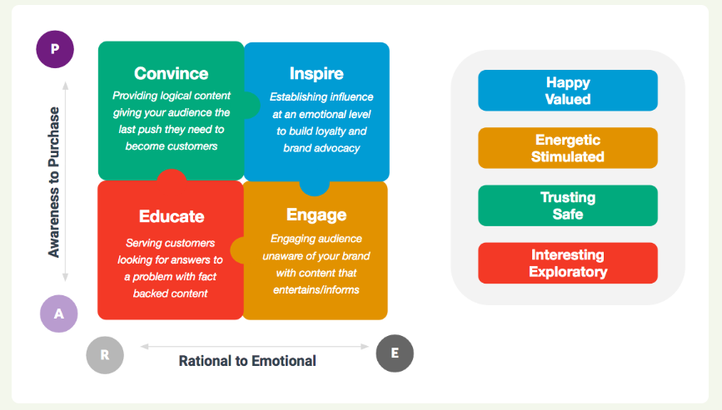
https://www.seedtoscale.com/blog/an-easy-to-apply-content-creation-framework

Slide 4
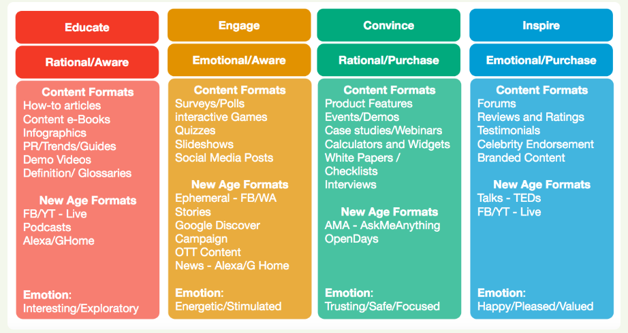
https://www.seedtoscale.com/blog/an-easy-to-apply-content-creation-framework

Slide 5
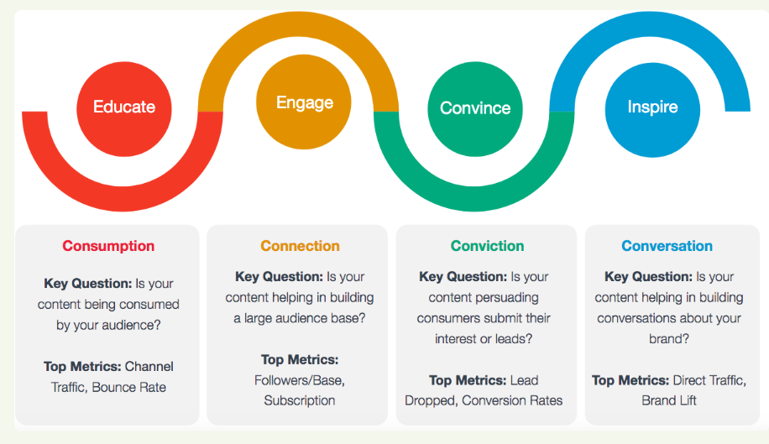
https://www.seedtoscale.com/blog/an-easy-to-apply-content-creation-framework

